Slide 1
Intrusion detection techniques using ANN
Professor Yun Zhang
Nasrin Eshraghi ivari

Slide 2
Table of content
Intrusion
Attacks
IDS
Solutions
Literature review

Slide 3
Intrusion
attempts to compromise the confidentiality, integrity, availability, or to bypass the security mechanisms of a computer system or network( illegal access).
Intrusions have many causes, such as malware (worms, spyware, etc…), attackers gaining unauthorized access to systems from the Internet, and authorized users of systems who misuse their privileges or attempt to gain additional privileges for which they are not authorized.

Slide 4
Types of Intrusions
Denial of Service (DoS)
Remote to User Attacks (R2L)
User to Root Attacks (U2R)
Probing
Notes:
DOS (Denial of service attacks): they aim to threaten services’ availability by saturating computer resources and servers of targeted networks. These attacks achieved in networks have as direct consequences the freezing of the network traffic.
▪ Probes: attacks that aim to gather diverse information on the target, which can help an attacker to start on attack. There exists many types of probe attacks: some abuse rightful users and others use the
engineering scheme to gather private information.
▪ R2L (Remote To Local): this attack aim to bypass or usurp authentication credentials of a target in order to execute some commands. Most of these attacks derive from social engineering [17].
▪ U2R (User To Root): Here, the attacks come from inside. The attacker usurps the administrator’s password and thus the others users’ credentials and data. Most of these attacks derive from the saturation of buffer caused by programming errors
A DoS attacks is a type of attack in which the hacker makes a memory resources too busy to serve legitimate networking requests and hence denying users access to a machine e.g. apache, smurf,Neptune, ping of death, back, mail bomb, UDP storm, etc.
• Remote to User attacks (RlL): A remote to user attack is an attack in which a user sends packets to a machine over the internet, and the user does not have access to in order to expose the machines vulnerabilities and exploit privileges which a local user would have on the computer, e.g. xlock, guest, xnsnoop, phf, sendmail dictionary etc.
• User to Root Attacks (U2R): These attacks are exploitations in which the hacker starts off on the system with a normal user account and attempts to abuse vulnerabilities in the system in order to gain super user privileges, e.g. perl, xterm.
• Probing: Probing is an attack in which the hacker scans a machine or a networking device in order to determine weaknesses or vulnerabilities that may later be exploited so as to compromise the system. This technique is commonly used in data mining, e.g. satan, saint,portsweep, mscan, nmap et

Slide 5
Intrusion detection
Intrusion detection
is the process of monitoring the events occurring in a computer system or network and analyzing them for signs of possible intrusions (incidents).
Intrusion detection system (IDS)
is a system that identifies, in real time, attacks on a network and takes corrective action to prevent those attacks. The primary responsibility of an IDS is to detect unwanted and malicious activities.
Notes:
There are commonly three information sources that IDS can handle: log files, applicative logs and network packets.
iDS are tools that detect attacks which cannot be detected at other security levels such as that of the firewall. One of the methods to implement intrusion detection systems is the neural network model.
Many authors have suggested network detection systems based on neural networks. The success of neural networks come from the fact that they are able to learn a number of behaviors depending on network’s input. In this work, we will dwell on neural network intrusion detection systems.

Slide 6

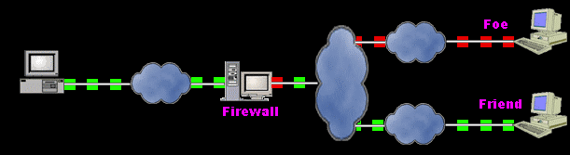
Common solution

Slide 7
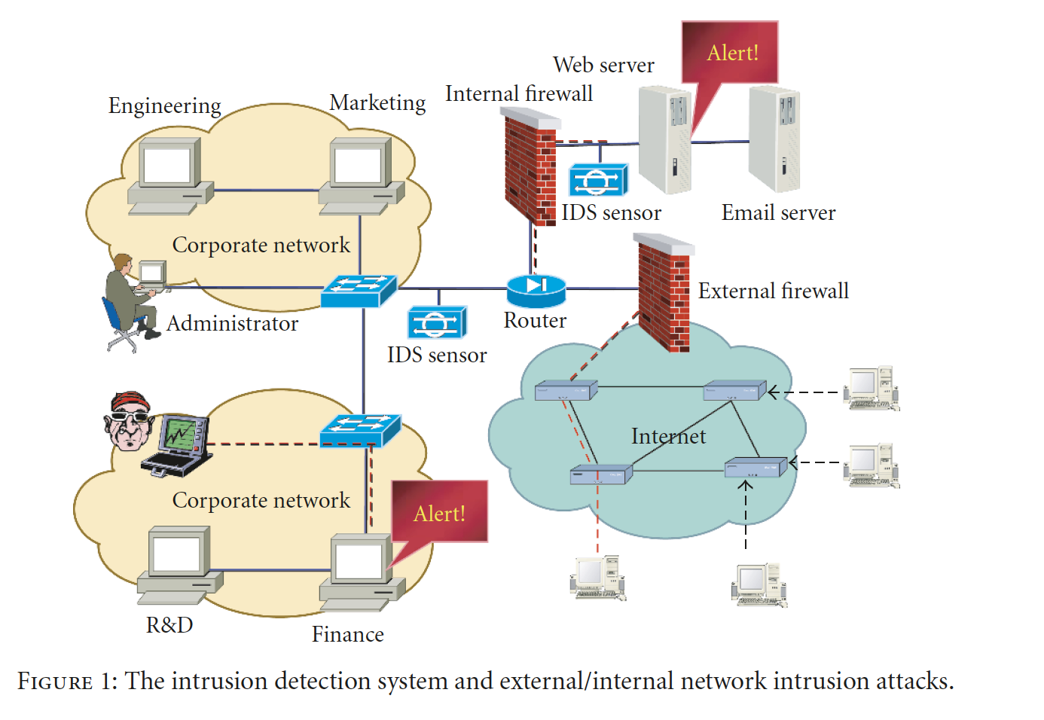

Slide 8
IDS techniques
signature based detection,
anomaly detection,
artificial intelligence (AI) based detection
Flexibility
Adaptability
Pattern recognition and possibly detection of new patterns
Learning abilities

Slide 9
Intrusion detection methods
Misuse detection
matches the activities occurring on an information system to the signatures of known intrusions
Anomaly detection
compares activities on the information system to the norm behaviour
Notes:
Misuse: 2nd pape
There are two main approaches to the design of IDSs. In a misuse detection based IDS, intrusions are detected by looking for activities that correspond to known signatures of intrusion or vulnerabilities. On the other hand,anomaly detection based IDS detects intrusions by searching for abnormal network traffic. The abnormal traffic pattern can be defined either as the violation of accepted thresholds for the legitimate profile developed for his/her normal behavior.
Misuse refers to known attacks that exploit the known vulnerabilities of the system. Anomaly means unusual activity in general that could indicate an intrusion. If the observed activity of a user deviates from the expected behavior, an anomaly is said to occur.
Misuse detection can be very powerful on those attacks that have been programmed in to the detection system. However, it is not possible to anticipate all the different attacks that could occur, and even the attempt is laborous. Some kind of anomaly detection is ultimately necessary. One problem with anomaly detection is that it is likely to raise many false alarms. Unusual but legitimate use may sometimes be considered anomalous. The challenge is to develop a model of legitimate behavior that would accept novel legitimate use.
It is difficult to build such a model for the same reason that it is hard to build a comprehensive misuse detection system: it is not possible to anticipate aU possible variations of such behavior. The task can be made tractable in three ways: (1) Instead of general legitimate use, the behavior of individual users in a particular system can be modeled. The task of characterizing regular patterns in the behavior of an individual user is an easier task than trying to do it for aU users simultaneously. (2) The patterns of behavior can be learned for examples of legitimate use, instead of having to describe them by hand-COding possible behaviors. (3) Detecting an intrusion real-time, as the user is typing commands, is very difficult because the order of commands can vary a lot. In many cases it is enough to recognize that the distribution of commands over the entire login session, or even the entire day, differs from the usual.

Slide 10
IDS types
Online
Off-line
Notes:
Paper 2
Off-line IDSs are run periodically and they detect intrusions after-the-fact based on system logs. On-line systems are designed to detect intrusions while they are happening, thereby allowing for quicker intervention.On-line IDSs are computationally very expensive because they require continuous monitoring. Decisions need to be made quickly with less data and therefore they are not as reliable.
IDSs also differ in whether they are on-line or off-line. Off-line IDSs are run periodically and they detect intrusions after-the-fact based on system logs. On-line systems are designed to detect intrusions while they are happening, thereby allowing for quicker intervention. On-line IDSs are computationally very expensive because they require continuous monitoring. Decisions need to be made quickly with less data and therefore they are not as reliable.
Several IDSs that employ neural networks for on-line intrusion detection have been proposed (Debar et al. 1992; Fox et al. 1990). These systems learn to predict the next command based on a sequence of previous commands by a specific user. Through a shifting window, the network receives the w most recent commands as its input. The network is recurrent, that is, part of the output is fed back as the input for the next step; thus, the network is constantly observing the new trend and "forgets" old behavior over time. The size of the window is an important parameter: If w is too small, there will be many false positives; if it is too big, the network may not generalize well to novel sequences. The most recent of such systems (Debar et al. 1992) can predict the next command correctly around 80% of the time, and accept a command as predictable (among the three most likely next commands) 90% of the time. One problem with the on-line approach is that most of the effort goes into predicting the order of commands. In many cases, the order does not matter much, but the distribution of commands that are used is revealing. A possibly effective approach could therefore be to collect statistics about the users' command usage over a period of time, such as a day, and try to recognize the distribution of commands as legitimate or anomalous off-line. This is the idea behind the NNID system.

Slide 11
Learning methods used in neural network-based nids
Self-organizing map (SOMs) → unsupervised
Backpropagation (BPN)
Radial basis function (RBF)
Notes:
9-Self-organizing maps (SOMs) :They are non-supervised methods of classification in which classes are discovered automatically. They are based on competitive learning. They are a visual method
created by Kohonen which allow to reduce the size of the input vector. As a result, it produces two cards of one or two sizes representing inputs. It is a scheme for extracting knowledge.
✓ Back propagation networks (BPN) :The algorithm of back propagation of mistakes is one of the methods which contributed to the development of neural networks. A back propagation of mistakes network is made of one input layer, one or two hidden layers and one output layer. The BPN can be used for classifying events such as attacks or normal traffic. One of their advantages is their generalization capacity and their natural ability of giving good approximations [6]. They are essentially used in prediction tasks they and facilitates supervised learning.
Radial Basic Function (RBF) network:RBF and MLPs are non-linear back propagation networks. They also give good approximations. The key difference between the two models is that a RBF model has one single hidden layer whereas the multi-layer perceptron has at least one hidden layer. The hidden layer’s function of a RBF network is a non-linear function and its output is linear whereas the output of the multi-layer perceptron is non-linear.
اگر یادگیری بر روی داده‌های بدون برچسب و برای یافتن الگوهای پنهان در این داده‌ها انجام شود، یادگیری بدون نظارت خواهد بود.
ک مجموعه از مثال‌های یادگیری وجود دارد بازای هر ورودی، مقدار خروجی یا تابع مربوطه نیز مشخص است. هدف سیستم یادگیر بدست آوردن فرضیه‌ای است که تابع یا رابطه بین ورودی یا خروجی را حدس بزند به این روش یادگیری با نظارت گفته می‌شود.
اصطلاحاً می‌گویند تمام داده ها تگ گذاری شده هستند.

Slide 12
LITERATURE REVIEW

Slide 13
Intrusion detection with neural networks jake ryan, meng-jang lin
The Neural Network Intrusion Detection(NNID) anomaly intrusion detection system is based on identifying a legitimate user based on the distribution of commands user executes every day.
NNID is a standard three layer backpropagation neural .
The system administrator runs NNID at the end of each day to see if the users' sessions match their normal pattern. If not, an investigation can be launched.
NNID provides an elegant solution to off-line monitoring.

Slide 14
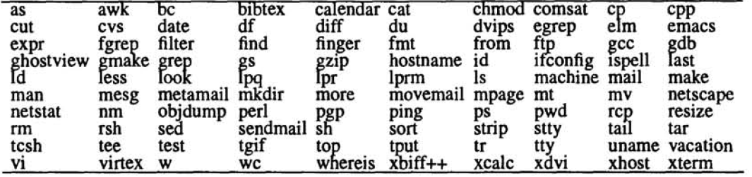
NNID
Building NNID for a particular computer system consists of the following three phases:
Collecting training data: Obtain the audit logs for each user for a period of several days. For each day and user, form a vector that represents how often the user executed each command.
Training: Train the neural network to identify the user based on these command distribution vectors.
Performance: Let the network identify the user for each new command distribution vector. If the network's suggestion is different from the actual user, or if the network does not have a clear suggestion, signal an anomaly.

Slide 15
NNID
problem with the on-line approach → predicting the order of commands
These results show that a learning offline monitoring system such as NNID can achieve better performance than systems that attempt to detect anomalies on-line in the command sequences, and with computationally much less effort.
Notes:
The MLP was trained to identify users’
profile and at the end of each log session, the MLP
evaluated the users’ commands for possible intrusions (offline).
The authors described their research in a small
computer network with 10 users. Each feature vector
described the connections of a single user during a whole
day. 100 most important commands are used to describe a
user’s behavior. They used a 3 layer MLP (2 hidden
layers). The MLP identified the user correctly in 22 cases
out of 24.

Slide 16
A neural network based system for intrusion detection and classification of attacks Mehdi MORADI and Mohammad ZULKERNINE
an off-line intrusion detection system is implemented using Multi Layer Perceptron (MLP) artificial neural network
a more general problem is considered in which the attack type is also detected. This feature enables the system to suggest proper actions against possible attacks
Notes:
When the neural network is
used, it identifies the input pattern and tries to output the
corresponding class. When a connection record that has no
output associated with it is given as an input, the neural
network gives the output that corresponds to a taught input
pattern that is least different from the given pattern [6].
The most commonly reported application of neural
networks in IDSs is to train the neural net on a sequence of
information units, each of which may be an audit record or
a sequence of commands. The input to the net consists of
the current command and the past w commands (w is the
size of window of commands under examination). Once the
net is trained on a set of representative command sequences
of a user, it constitutes (learns) the profile of the user and
when put in action, it can discover the variance of the user
from its profile [4], [6]. Usually recurrent neural networks
are used for this purpose.

Slide 17
Attack Types
Features: Selection, Numerical Representation, and Normalization
Notes:
implemented systems were neural networks with two possible outputs: normal or anomaly. In these studies, some types of attacks and a set of normal records were included in the dataset; however, the output of the neural network was 1 or 0 for normal or attack conditions (the attack type was not determined by the neural network). The present study is aimed to solve a multi class problem in which not only the attack records are distinguished from normal ones,but also the attack type is identified.

Slide 18
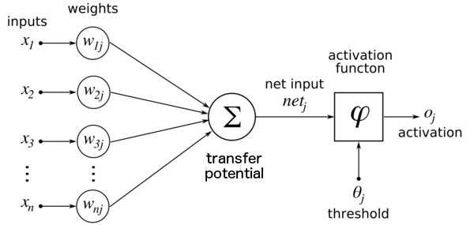
Intrusive Detection Systems Design based on BP Neural Network Zhang Wei, Wang Hao-yu
BP has better persistence and timely prediction.

Slide 19
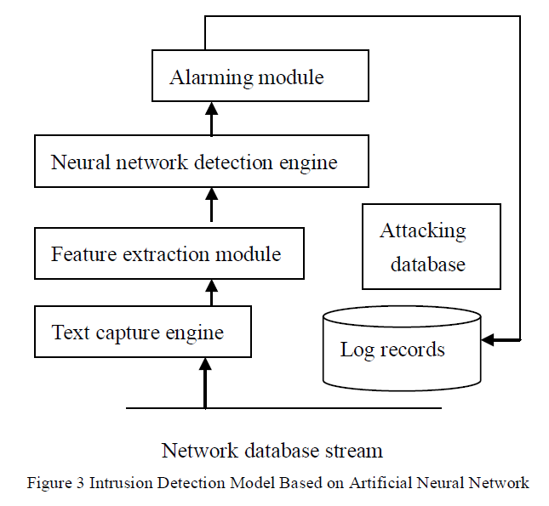
BPNN
The selection of layers
The determination of neuron number of input layer and output layer
The determination of the number of neurons of hidden layer
Notes:
text capture engine capture all network data stream flowed through system monitoring network segment,feature extraction module analyze and process the captured network data flow, extract out the feature vector which completely and accurately represent the data stream and submit the eigenvector to the neural network classification engine so as to take it as input vector of the neural network classification engine, neural network classification engine distinguish the intrusive action by analyzing and processing this feature. If after analyzing and processing, the neural network classification engine consider it as a kind of aggressive behavior, it will send a warning message to the user, and record the attack-related information in the log so as to gather evidence securely afterwards; if alarm information is of great value for the perfecting and updating of attacking sample store, such as the discovery of an unknown type of aggressive behavior (defined as the attack type which neural networks have not learned), this attack can be added into the attacking sample store in the participation of the user to prepare for re-learning of neural network classification engine. This reflects the neural networks possesses the capacity of continuous learning so as to identify more types of aggressive behavior, and also is a prudent advantage and highlight of neural network intrusion detection system compared to the general rule-based
intrusion detection system, it is of great value for the practical application of intrusion detection systems.
The particularly need to note is that: the training of neural network classification engine is conducted off-line, its retraining will be carried on in the basis of the time interval set by the administrator and the information of attacking database to adapt to the changing methods of attack, which is able to better guarantee detection efficiency.

Slide 20
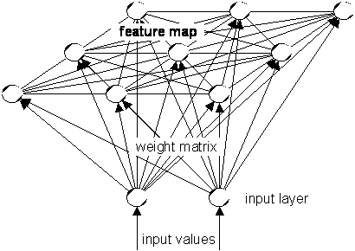
4. Intrusion Detection System Using Self Organizing Maps V. K. Pachghare
A self-organizing map (SOM)
trained using unsupervised learning to produce a low-dimensional
There is no hidden layer
Notes:
The Self-Organizing Map is a neural network model or analyzing and visualizing high dimensional data. It belongs to the category of competitive learning network. The SOM Fig. 1 defines a mapping from high dimensional input data space onto a regular twodimensional array of neurons. It is a competitive network where the goal is to transform an input data set of arbitrary dimension to a one- or two-dimensional topological map. The SOM aims to discover underlying structure, e.g. feature map, of the input data set by building a topology preserving map which describes neighborhood relations of the points in the data set
The SaM is often used in the fields of data compression and pattern recognition. There are also some commercial intrusion detection products that use SaM to discover anomaly traffic in networks by classifying traffic into categories. The structure of the SaM is a single feed forward network, where each source node of the input layer is connected to all output neurons. The number of the input dimensions is usually higher than the output dimension.

Slide 21
Data Collection
to collect distinct and various kinds of network packets. To collect data we can use any packet sniffer
Vector Extraction
Training Self Organizing Map

Slide 22
Appendix

Slide 23
Misuse Detection
pattern matching
Intrusion Patterns:
Sequences of system calls, patterns of network traffic, etc.
intrusion
activities
Example: if (traffic contains “x90+de[^\r\n]{30}”) then “attack detected”
Problems?
Can’t detect new attacks

Slide 24
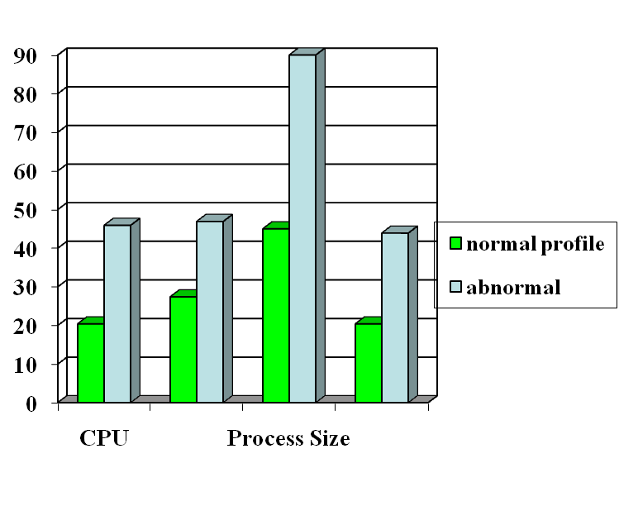
Anomaly Detection
probable intrusion
activity measures
Define a profile describing “normal” behavior, then detects deviations.
Any problem ?
Relatively high false positive rates
Anomalies can just be new normal activities.
Anomalies caused by other element faults
E.g., router failure or misconfiguration, P2P misconfig
Which method will detect DDoS SYN flooding ?

Slide 25
Components of Intrusion Detection System
Audit Records
system activities are observable
Audit Data Preprocessor
Activity Data
Detection
Models
normal and intrusive activities have distinct evidence
Detection Engine
Alarms
Action/Report
Decision
Table
Decision Engine

Slide 26
Architecture of Network IDS
Signature matching
(& protocol parsing when needed)
Protocol identification
TCP reassembly
Packet capture libpcap
Packet stream

Slide 27
Neural Network Classification
Capability of the neural network largely depends on the learning algorithm and the network architecture used
Learning algorithms typically used
Error Correction learning
Hebbian learning
Competitive learning, etc.
Network architectures typically used
Single layer feedforward
Multilayer feedforward
Recurrent networks, etc.

Slide 28
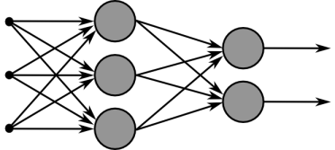
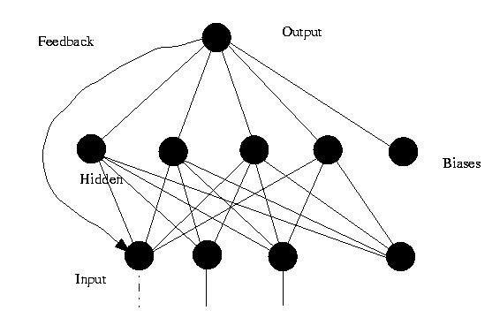
Multilayer feedforward network
Recurrent network

Slide 29
Traditional Neural Network Based IDS
Typically consist of a single neural network based on either misuse detection or anomaly detection
Neural network with good pattern classification abilities typically used for misuse detetction, such as
Multilayer Perceptron
Radial Basis function networks, etc
Neural network with good classification abilities typically used for anomaly detetction, such as
Self organizing maps (SOM)
Competitive learning neural network, etc

Slide 30
Hybrid Neural Network Approach
Combination of Misuse detection and anomaly detection based systems
Clustering results in dimensionality reduction
Classification attains attack identification
Advantages
Improved accuracy
Enhanced flexibility
Examples
SOM and MLP using back propagation
SOM and RBF
SOM and CNN, etc

Slide 31
Hybrid Neural Network Approach 1 (Using SOM and MLP)
SOM employing unsupervised learning used for clustering
MLP emplying Back Propagation Algorithm used for classification
Output from SOM is given as input to MLP

Slide 32
Self Organizing Maps
Based on competitive learning
Winner takes all neuron
Forms a topographic map of input patterns
ie. spatial locations of neurons in the lattice are indicative of statistical features contained in the input patterns

Slide 33
SOM Procedure
Initialization of synaptic weigths
Competition
Euclidean distance
Cooperation
topological neighbourhood
Adaptation
learning rate

Slide 34
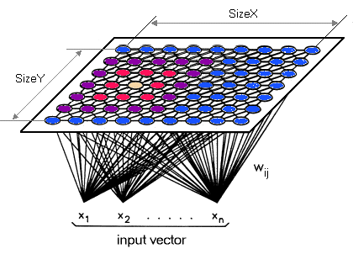
A Self Organizing Map

Slide 35
Back-Propagation Algorithm
A case of supervised learning
Typically used for multilayer perceptrons
Two stages, forward pass and backward pass
In forward pass input signal propagtes forward to produce the output
In backward pass, synaptic weights are updated in accordance with the error signal, which is then propagated backwards

Slide 36
Weight Correction for BPA
Error signal at output neuron j
e_{j}(n) = d_{j}(n) – y_{j}(n)
Weight correction factor,
∆ w_{ji} (n) = η δ_{j}(n) y_{i}(n)
where, δ_{j}(n) = ej(n)Φ'(v_{j}(n)) → j is o/p neuron
= Φ'(v_{j}(n) Σ δ_{k}(n)w_{kj}(n) → j is hidden neuron

Slide 37
Operational Procedure
Selection of input and output variables
Data prepocessing and representation
Data normalization
Selection of network structure, training and testing

Slide 38
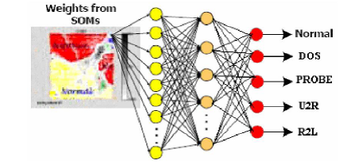
Proposed hybrid SOM_BPN Neural Network

Slide 39
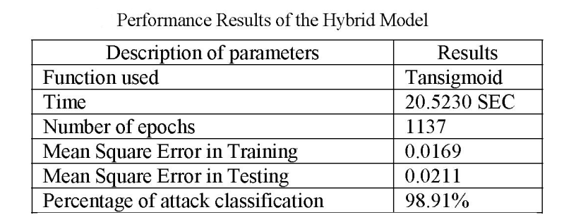
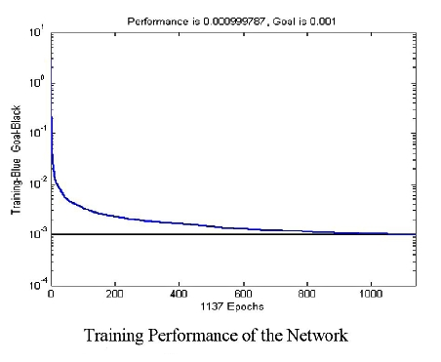
Simulation Results

Slide 40
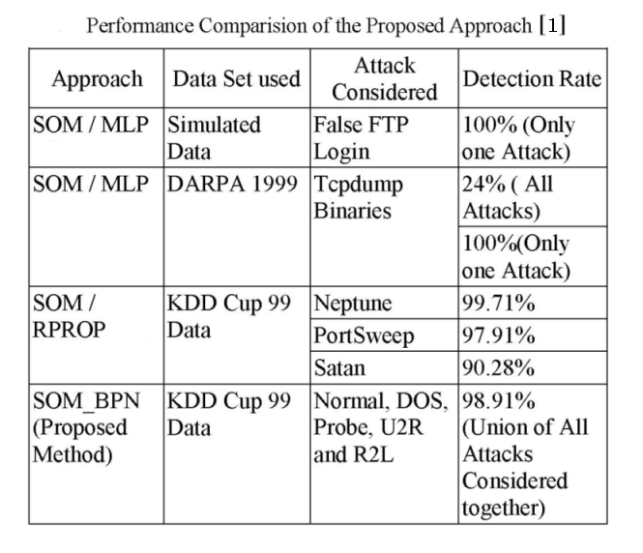
Simulation Results (contd)

Slide 41
Hybrid Neural Network Approach 2 (Using SOM and RBF)
SOM employing unsupervised learning used for clustering
RBF for classification
Output from SOM is given as input to RBF network

Slide 42
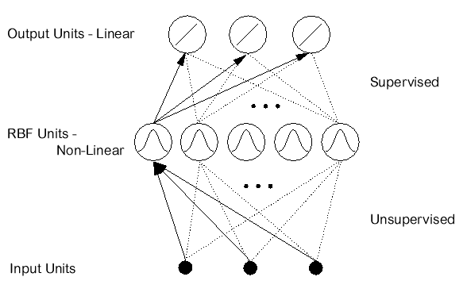
Basics of RBF Network
Typically used for function approximation, pattern classification, etc
Two layer feed-forward structure with each hidden unit implementing radial activated function
Training involves updating centers of network for hidden neuron and output layer weights

Slide 43
Training of RBF network
Unsupervised learning to update centers of hidden neurons
k' = arg(min_{k} ||X(n) – C_{k}(n)||)
C_{k}(n + 1) = C_{k}(n) + μ[X(n) – C_{k}(n)] ... if k = k'
= C_{k}(n) ... otherwise
Supervised learning to update output layer weights
w_{k}(n + 1) = w_{k}(n) + μ[d(n) – Y(n)] e^{-ζ}
where ζ = ||X - C_{k}||²/(σ²_{k})

Slide 44
Summary
What is Intrusion Detection System?
AI and Intrusion Detection
Neural Network fundamentals
Hybrid neural network approach for Intrusion Detection using
(i) SOM and BPN
(ii) SOM and RBF

Slide 45
References
[1] “Network Intrusion Detection using Hybrid Neural Network”, P. Ganesh Kumar, et al., IEEE – ICSCN 2007, India, pp. 563 – 569
[2] “A Hybrid Neural Network Approach to Classification of Novel Attacks for Intrusion Detection”, Wei Pan, et. al., LNCS 3758, 2005, pp. 562 – 675
[3] “Neural Networks – A Comprehensive Foundation”, Simon Haykin, 2nd Edition, Prentice Hall, 1999

Slide 46
Learning Techniques in Neural Networks
Supervised Learning
In supervised learning, the training data is input to the network, and the desired output is known weights are adjusted until production yields desired value.
Unsupervised Learning
The input data is used to train the network whose output is known. The network classifies the input data and adjusts the weight by feature extraction in input data.
Reinforcement Learning
Here the value of the output is unknown, but the network provides the feedback on whether the output is right or wrong. It is Semi-Supervised Learning.
Offline Learning
The adjustment of the weight vector and threshold is made only after all the training set is presented to the network. It is also called Batch Learning.
Online Learning
The adjustment of the weight and threshold is made after presenting each training sample to the network.

